Slide 1
Project Management
Lecture 5
Ruzanna Chitchyan, Jon Bird, Pete Bennett
TAs: Alex Elwood, Alex Cockrean, Casper Wang
(Using materials created by N. Walkinshaw and R. Craggs)
Notes:
RC

Slide 2
Overview
About Measurement
Measurement under White Box:
Lines of code
Cyclomatic Complexity
Measurement under Black Box:
Planning Poker
Software Laws:
Patents, Copyright, Contract, Privacy
Notes:
Introduce the objectives for the module.

Slide 3
Measurement is Central to Quality
How to plan for the project time and effort?
For the team?
For the customer?
Which software/part of it needs more time for testing?
Which developer should get a bonus payment for productivity?....
“You cannot control what you cannot measure.”
Tom DeMarco, 1982

Slide 4
What is “Measurement”?
Attributing values to objects.
The fuel efficiency of a car (gallons per mile)
The number of goals scored by a footballer
The cost of a house
Can use these values as basis for comparison
What is the cheapest house?
Who is the best goal scorer?
Can use these measurements and comparisons to make better decisions.
Which car should I buy (e.g., given five candidate cars)
Which striker should I put in my team?

Slide 5
Measurement is Difficult in Software Engineering
Most entities are difficult to measure reliably
Difficult or impossible to “pin down” a single value
E.g., Software Quality (ISO/IEC 25010):

Slide 6
Usual Metrics: Size and Complexity
After development ...
How much effort will it require for maintenance?
Where should we direct testing effort?
How much effort was required for development?
Metrics are based upon source code (“white box”)
Before development has started ...
How much programming effort will module X require?
What will be the estimated cost of the final product?
Metrics are based upon requirements / specification (“black box”)

Slide 7
White Box Complexity Metrics

Slide 8
Number of lines in a file (or a group of files)
Easy to compute
Easy to understand and interpret
Often sufficient for an approximate measure of size
Widely used (perhaps the most widely used) metric
Comments
What is a line?
Blank lines
Not all “lines” are equal
Ignores logical/ architectural complexity
Highly language-specific

Slide 9
Example: Who is the most productive programmer?
Measured in lines of code

Slide 10
Example: Who is the most productive programmer?
Measured in lines of code
Designed entire
system. Wrote
highly efficient
algorithmic core.
Copied and pasted license text into every source file.

Slide 11
Cyclomatic Complexity
Calculated from the control flow graph:
V(G) = E – N + 2P
E – number of edges;
N – number of nodes;
P – number of procedures (usually 1)
Number of independent paths through the code
Independent path – any path that introduces at least one new statement/condition

Slide 12



Number of Edges = 27
Number of Nodes = 22
V = 27 – 22 + 2 = 7
Triangle Example

Slide 13
Black Box Complexity Merics

Slide 14
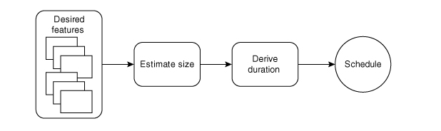
Estimating Agile Projects
Figure from: Agile Estimating and Planning by Mike Cohn

Slide 15
Storey Points (Size Estimation)
An informal, agile unit of “size measurement”
Usually an estimate from 1-10
Derive an estimate from the whole team at sprint planning meetings
Based on the idea of the “Wisdom of the Crowds”
The collective estimate of groups (i.e., of effort required for a story) is better than the estimate of an individual

Slide 16
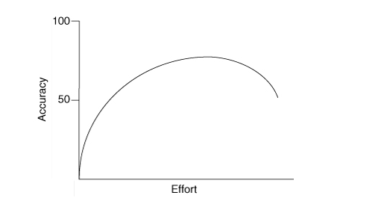
Accuracy vs Effort in Project Estimation
Figure from: Agile Estimating and Planning by Mike Cohn

Slide 17
Planning Poker
The whole team is involved
Each member is given a set of numbered cards
Numbers follow the Fibonacci sequence
1,3,5,8,13,20,...
Larger tasks become harder to estimate in exact terms
Low values - trivial to implement
High values - difficult to implement
Each member is also given a “?” card

Slide 18
Planning Poker: Process

Slide 19
Planning Poker: Process
“I think it’s difficult because …”

Slide 20
Planning Poker: Process
Cycle repeats for a maximum of 3 iterations (to avoid infinite loops!)

Slide 21
Team Velocity
Number of (estimated) story points implemented per sprint.
Can be derived from previous sprints.
e.g., Average points implemented from previous x sprints.
Can be used to estimate:
Time required to complete project.
Target number of stories that can be completed in a sprint.

Slide 22
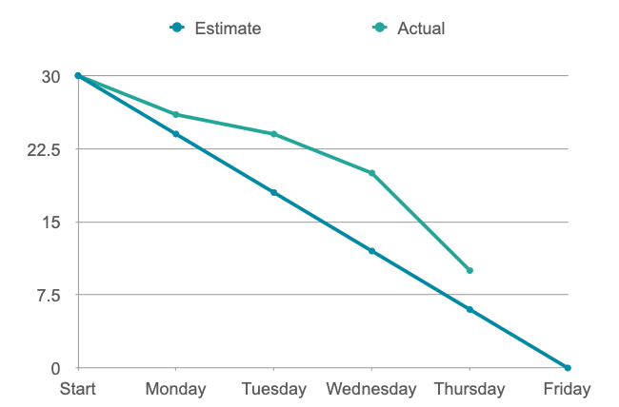
Burn Charts

Slide 23
Software Laws: Patents, Copyright, Contract, Privacy

Slide 24
Patent Law
A government license giving a right for a set period, especially to exclude others from making, using, or selling an invention
Granted by the government
to stop others exploiting your invention
Lasts 20 Year
Inventions Must
be new
be an inventive step (not an obvious improvement)
capable of industrial application

Slide 25
The “Social Network”
Did Mark Zuckerberg infringe a patent?
No patent was granted
The idea was not new, social networks existed before this

Slide 26
Copyright
Creator has exclusive rights to perform, copy, adapt their work.
Everyone else must get Permission (and possibly pay)
"literary, dramatic, musical and artistic works" includes software
Automatically owned (not granted)
Lasts 70 years after authors death (lots of exceptions)
This affects software in 2 different ways:
Illegal Copies of Applications (Piracy) !
Using someone else's code/UI design/etc. in your application
(Not the "idea" but the actual "stuff" (code, design, documents) created by someone else)

Slide 27
Copyright Theft?
NO:
Get permission (obtain a licence)
Be within "fair use" (e.g. for study or review)
Use "open source" software
Create something similar yourself, independently
"Obvious" code can't be copywrited
YES:
Displaying an image from another page
Using code found on the internet
Copying Windows 95 for your friends

Slide 28
The “Social Network”
Did Mark Zuckerberg infringe copyright?
Maybe
but there is no evidence he copied
it it's not fair use
it wasn't OSS
he saw the code so didn't invent it himself

Slide 29
Contract Law
Employer contracts usually force an employee to:
Not work for anyone else
Hand over any ideas (Intellectual Property)
Not disclose company secrets (Non-disclosure-agreements)
(even after you stop working for them)

Slide 30
The “Social Network”
Did Mark Zuckerberg break contract?
Probably Not
there was no written contract
he did not disclose any secrets about the other project

Slide 31
Data Protection
8 Principles of Data Protection:
Any company storing "personal data" must make sure it is:
fairly and lawfully processed (consent, contractual and legal obligations, public interest, ...)
processed for limited purposes;
adequate, relevant and not excessive;
accurate and, where necessary, kept up to date;
not kept longer than necessary;
processed in accordance with the data subject's rights;
secure; not transferred to countries without adequate protection
UK : Data Protection Act
EU : Data Protection Directive
US : a "patchwork" of state and national laws

Slide 32
Review
How can we measure complexity?
Why do we use black box options?
What is a patent
What is the difference between patent and copyright?
What do we learn about contract from Social Network?
Notes:
A. System behavior is how a system acts and reacts. It is an outwardly visible and testable activity of a system.
B. A use-case model describes a system’s functional requirements in terms of use cases. It is used to communicate with the end users and the domain experts. A benefit includes buy-in at an early stage of system development.
C. An actor is anything that exchanges data with the system and is external to the system. A use case is a sequence of actions a system performs that yields an observable result of value to a particular actor.
D. An activity diagram in the use-case model can be used to capture the activities in a use case. It is essentially a flow chart, showing flow of control from activity to activity.

